Slide 1
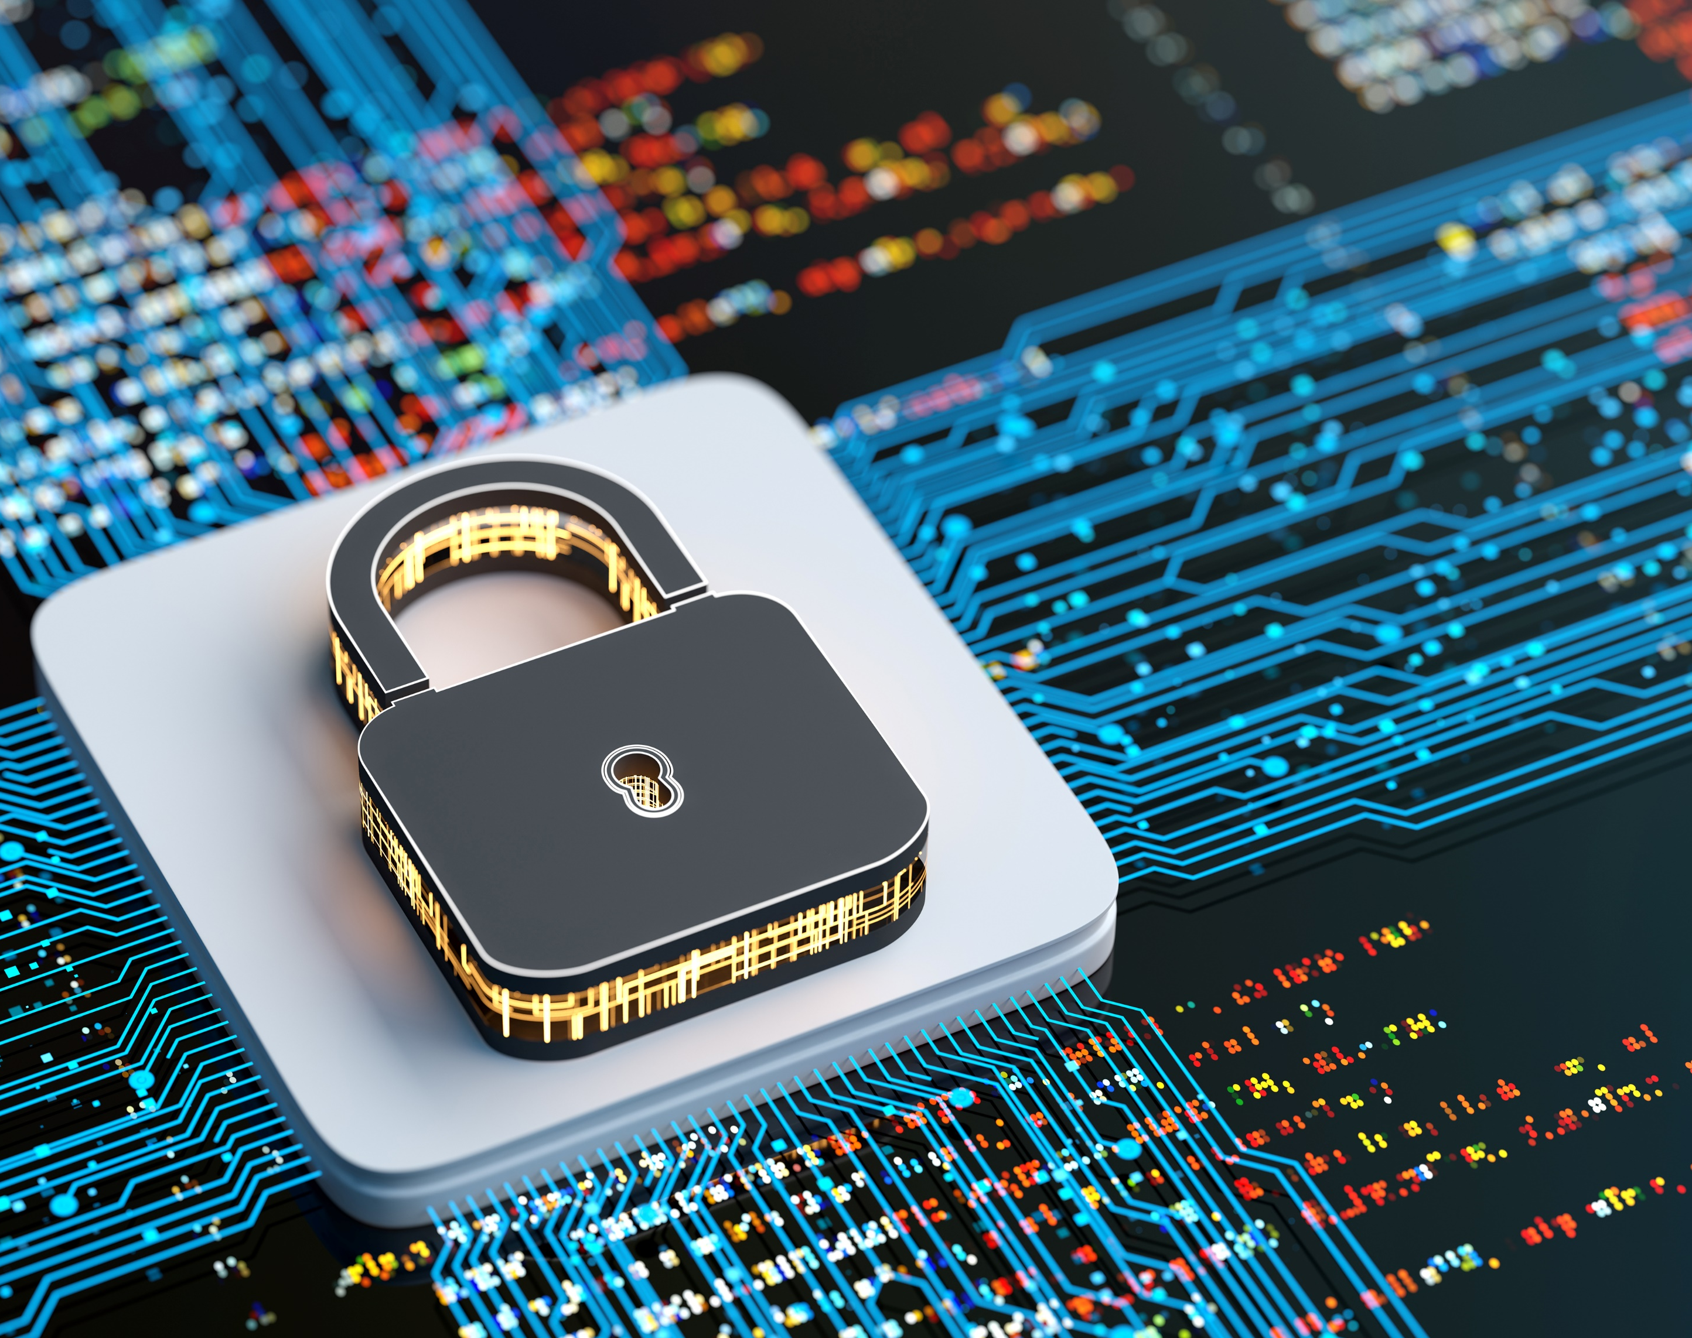
SECURITY AWARENESS

Slide 2
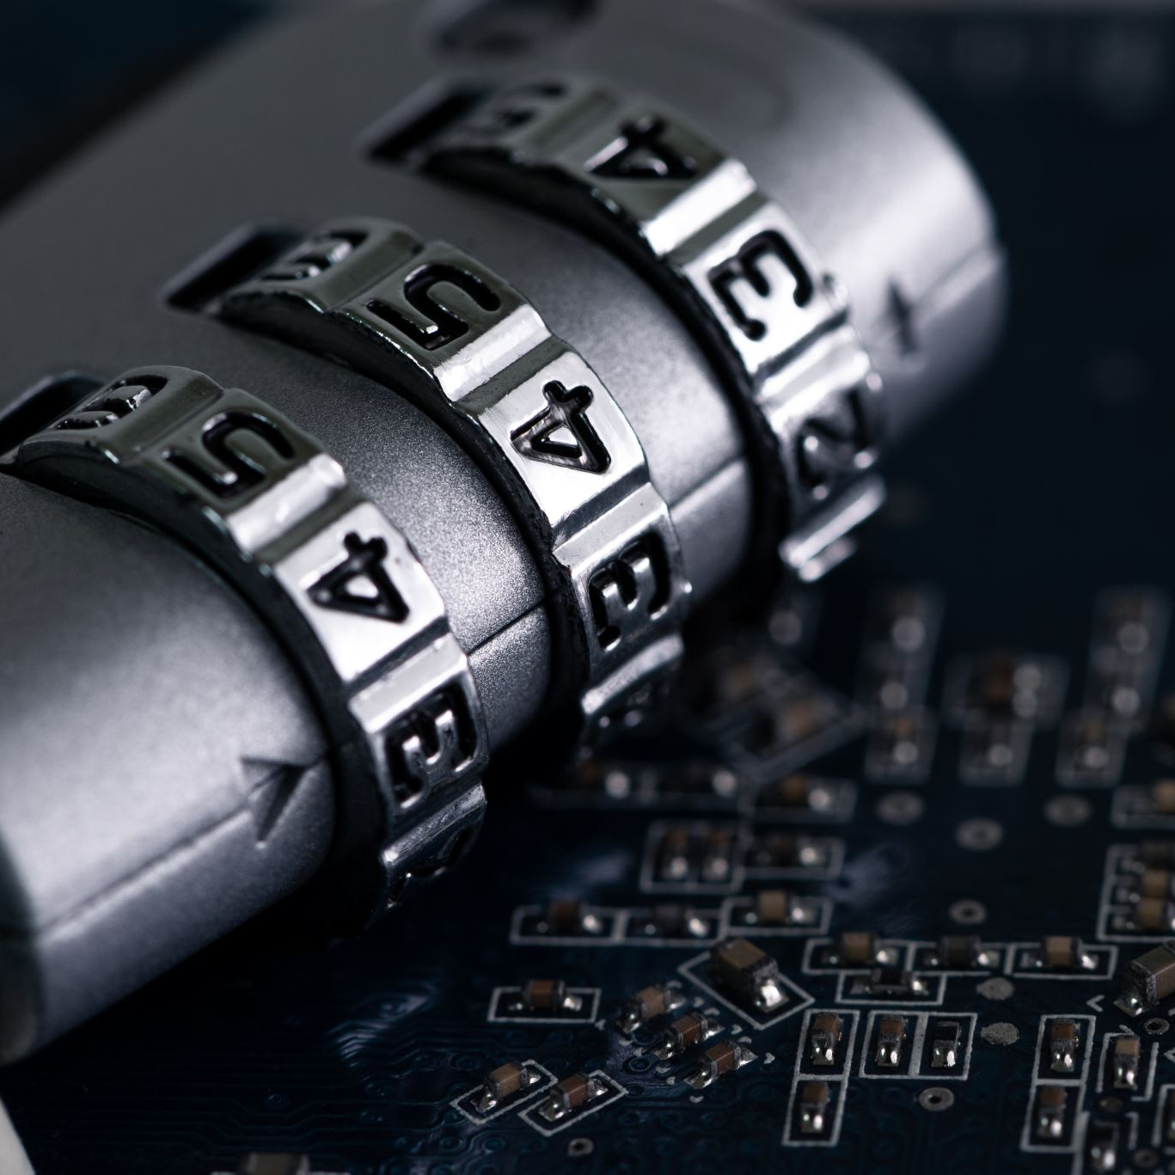
Introduction:
What is Security awareness?
Security awareness refers to the knowledge and understanding that employees and individuals need to have regarding the protection of information and systems from cyber threats. It involves being vigilant and proactive in identifying and preventing security risks that can harm an organization’s data, reputation, or financial stability.

Slide 3
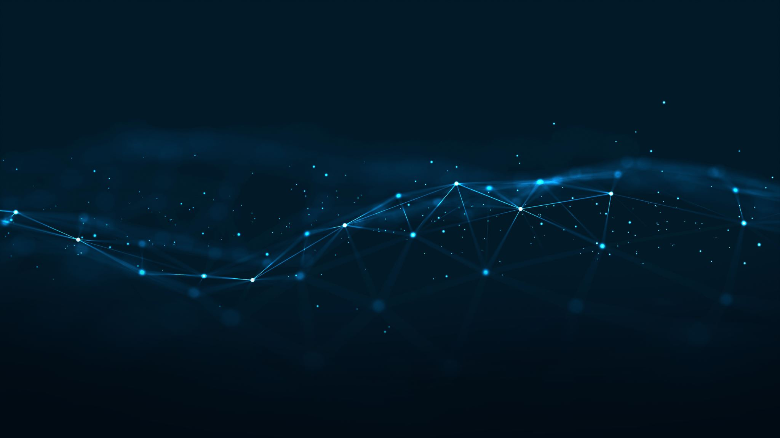
HERE ARE SOME KEY POINTS ABOUT SECURITY AWARENESS
1. Importance of Security Awareness: Employees are often the first line of defense against cyberattacks. A single security breach can lead to severe consequences, including financial loss, reputational damage, and legal implications. Being aware of potential risks, such as phishing, malware, and social engineering, helps reduce these vulnerabilities.
2. Common Cyber Threats:
. Phishing: Fraudulent emails that appear to be from legitimate sources, tricking users into sharing sensitive information.
. Social Engineering: Manipulative tactics where attackers exploit human behavior to gain access to confidential information.
. Malware and Ransomware: Malicious software that can damage systems or lock users out of their own data until a ransom is paid.
Best Practices for Maintaining Security:
Strong Passwords and Multi-Factor Authentication (MFA): Use complex passwords and enable MFA for extra security.
Recognizing Suspicious Activities: Be cautious of unsolicited emails, unusual links, or unexpected attachments.
Safe Internet Use: Avoid unsafe websites, download software from trusted sources, and keep devices updated.
Company Policies and Procedures: Organizations have specific security policies that dictate how employees should handle data, report incidents, and use IT resources. It is crucial to follow these protocols to maintain a secure environment.
Ongoing Training and Vigilance: Security awareness is a one-time event. Employees should participate in regular training, stay informed about new threats, and promptly report any suspicious behavior or potential breaches.

Slide 4
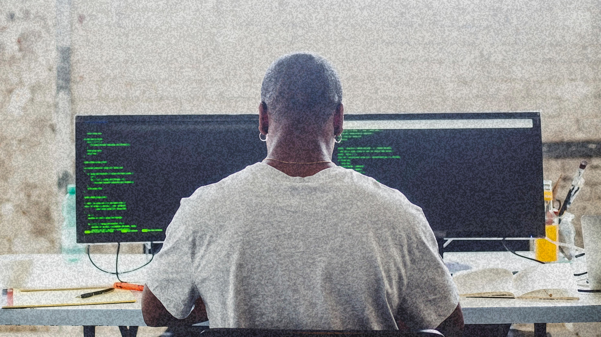
Importance of Security Awareness

Slide 5

Understanding the Role of Employees
Employees are the first line of defense in cybersecurity
Your actions directly impact the security of the organization’s data and systems

Slide 6
Consequences of Security Breaches
Breaches can lead to financial loss, reputational damage, and legal issues
Examples: Data theft, loss of customer trust, and costly recovery efforts

Slide 7
Why Awareness Matters
Awareness helps prevent human errors that cybercriminals exploit
Everyone must be vigilant and proactive in preventing security incidents

Slide 8
COMMON CYBER THREATS

Slide 9

PHISHING ATTACKS
Cybercriminals send fraudulent emails pretending to be from legitimate sources
These emails trick people into providing sensitive data
Never click on unknown links or open unexpected attachments
Verify the sender’s email address and scrutinize the content before responding

Slide 10

Attackers manipulate individuals into giving confidential information or access
This can occur via phone calls, emails, or even face-to-face interactions
Verify the identity of anyone requesting sensitive information
Be cautious of unusual requests and report any suspicious behavior
SOCIAL ENGINEERING

Slide 11
Malware And Ransomware
Malware: Malicious software that can infect systems and steal data
Ransomware: Locks access to files or systems until a ransom is paid
Avoid downloading software or files from unknown sources
Keep antivirus software updated and scan regularly for threats

Slide 12

Best Practices for Maintaining Security

Slide 13
Use Strong Passwords and Multi-Factor Authentication
Passwords should be long and contain a mix of letters, numbers, and symbols
Use MFA to add an extra layer of security when logging into systems
Never reuse passwords across multiple sites
Implement MFA on all accounts, especially for sensitive data

Slide 14
Recognizing Suspicious Emails and Attachments
Be wary of emails with urgent requests, unexpected attachments, or suspicious links
Phishing emails often use a fake sense of urgency to trick recipients
Verify emails by contacting the sender directly before taking any action
Report any suspicious emails to your IT or security team

Slide 15
Safe Internet Use
Ensure websites are secure
Avoid downloading software from untrusted or unofficial sources
Only visit reputable websites and download from trusted platforms
Regularly update your browser and operating system to fix security vulnerabilities

Slide 16
Locking Devices and Handling Sensitive Data
Lock your computer whenever you leave your desk, even for short periods
Don’t share sensitive data over unsecured channels
Always lock your workstation when away from your desk
Follow company protocols for sharing and storing confidential information securely

Slide 17

Company Policies and Procedures

Slide 18
Familiarize Yourself with Security Policies
Understand and comply with company policies on IT usage, data protection, and email use
Know how to handle sensitive information and avoid risky behaviors
Review the company’s security policies regularly to stay updated
Ask questions if you’re unsure about a policy or practice

Slide 19

Incident Reporting
Report any suspicious behavior, potential security breaches, or strange system activities immediately
Reporting incidents early helps prevent larger security issues
Know who to contact in case of a security incident
Document what happened, including any emails or other evidence

Slide 20
Consequences of Security Violations
Understand the potential disciplinary actions or legal consequences for violating security policies
Know that mishandling data or breaking protocols can result in job loss or legal action
Always follow security protocols to avoid serious consequences
Take responsibility for your actions and report any mistakes immediately

Slide 21
Ongoing Training and Vigilance

Slide 22
Participate in Regular Training
Attend mandatory security training sessions and complete any required e-learning modules
Stay informed on the latest cybersecurity threats and trends
Take time to engage with available training resources
Use the knowledge to adapt your security practices

Slide 23
Be Vigilant About Security Threats
Be alert for any signs of phishing, social engineering, or suspicious activity
1
Stay proactive in identifying and mitigating risks
2
Report suspicious activities even if you’re unsure whether they’re a threat
Always be cautious with unknown links, files, or requests for sensitive information

Slide 24
Utilize Company Resources
Use internal resources such as knowledge bases, IT support, and security newsletters to stay informed
Reach out to your security team if you have questions or concerns
Check for updates from your security team regularly
Use the company’s tools and resources to stay ahead of emerging threats

Slide 25
Summary:
Security awareness is crucial for every employee as cyber threats continually evolve. By understanding common threats like phishing, social engineering, and malware, and applying best practices such as using strong passwords, recognizing suspicious activity, and adhering to company policies, employees can actively protect the organization. Ongoing training, vigilance, and immediate reporting of incidents are essential in maintaining a secure environment. Together, these actions contribute to minimizing risks and ensuring the safety of sensitive data and systems.

